Slide 2
Intro to Rhetoric Notes (PG 83)
What is rhetoric?
Aristotle wrote that “rhetoric may be define as the faculty of observing in any given case the available means of persuasion.”
The strategic use of communication to both persuade and accomplish purposes with target audiences
Put simply: the art of persuasion.

Slide 3
Intro to Rhetoric Notes (PG 83)
Where do see see, find, and use rhetoric?
EVERYWHERE! From everyday discussions and conversation, movies, books, advertisements, art, tv, social media…
Thinking being conscious of rhetoric will help you to be successful communicators. Perhaps equally important, it will help you be a more discerning of the world around you.
*Make sure you draw the image on the next slide in your notes.

Slide 4
Intro to Rhetoric Notes (PG 83)
When we examine rhetoric, we’re looking closely athe the interactions between and among three key elements:
Speaker (or writer)
Subject
Audience
These are the components that make up Aristotle’s Rhetorical Triangle.
*Make sure you draw the image on the next slide in your notes!

Slide 5
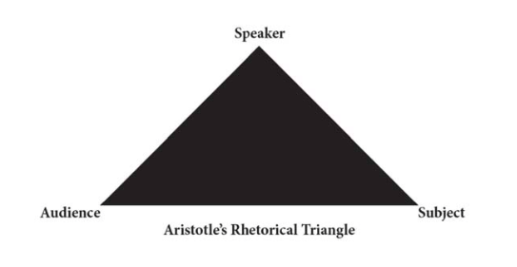
Intro to Rhetoric Notes (PG 83)
Notes:
Make sure to draw this in your notes!

Slide 6
Intro to Rhetoric Notes (PG 83)
Subject:
For the subject, you must consider what the speaker’s/writer’s topic or the content that they are writing about.
Prior to writing/speaking:
Writer evaluates what he/she already and needs to know
Investigates perspectives
Identifies and distinguishes the kinds of evidence that will be most useful
This is the area with which you probably have the most experience as you’ve already have an understanding of conducting research, backing up claims with evidence, etc.

Slide 7
Intro to Rhetoric Notes (PG 83)
Audience:
While there are usually multiple audiences that a piece or work will reach, a speaker/writer will already have a primary audience in for their work and will tailor the piece to fit the expectations, prejudices potential objections, or interests of that group.
Ex: President Obama would definitely use a different approach when delivering a proposal to his family than he would to, say, a board made up of members from the GOP.
When you need to identify the audience for a piece of rhetoric, don’t just use the blanket term “the reader”, think more deeply about the person or people that you are addressing.

Slide 8
Intro to Rhetoric Notes (PG 83)
Speaker:
Using who you are, what you know, and how you feel to make decisions about how you present information.
This can impact the type of language used (formal vs. informal), tone, style, and just about every other aspect of the way communication is presented.
Persona→ the character the speaker creates as he or she writes.

Slide 9
Intro to Rhetoric Notes (PG 83)
Context/Aim:
The situation in which the reading and writing occur.
What is the intention of the speaker/writer? How might the audience perceive the intentions?

